Slide 1
Adaptive design
A developer's guide to Windows 10 insider preview
Andy & Jerry

Slide 2
The Microsoft design language
How Windows makes design easier
What am I designing?
Techniques to adapt

Slide 3
The Microsoft Design Language

Slide 4
Microsoft design language principles
Keep it Simple Isn’t it nice when things just work, when the next step is intuitive, and people are inspired? | Make it Personal We design for real people, not requiring people can fit into our design. Personal means human.
Think Universal Better technology for anyone is better technology for everyone. It’s an attitude. | Create Delight Attention of detail equals moments of delight. Sometimes delight is so perfect it is invisible.
Design as One Work together and do amazing things. Many teams, one ecosystem, happy customers.

Slide 5
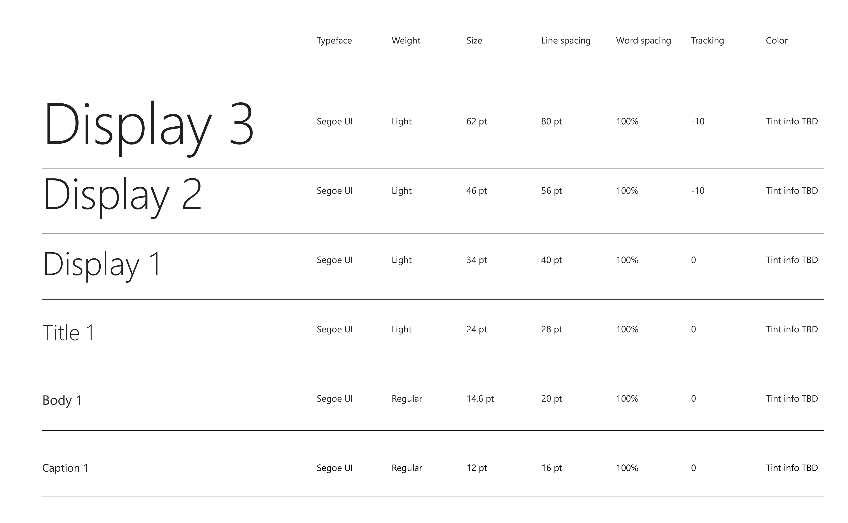
Typeography

Slide 6
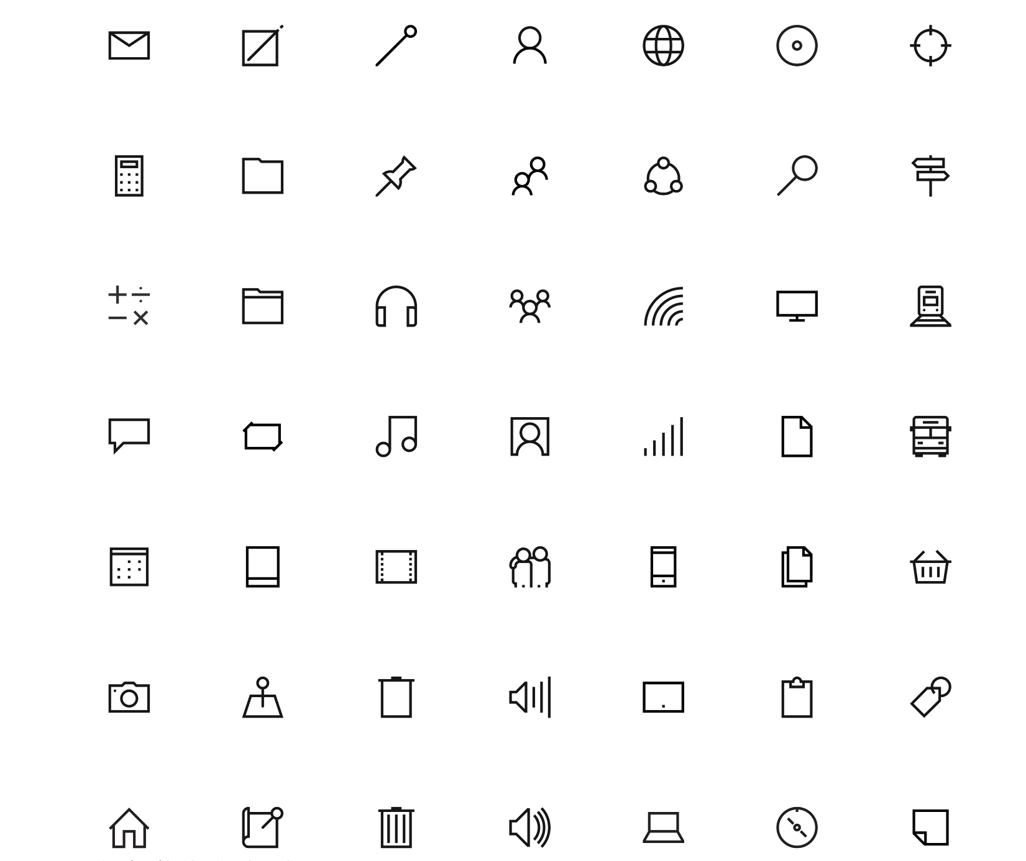
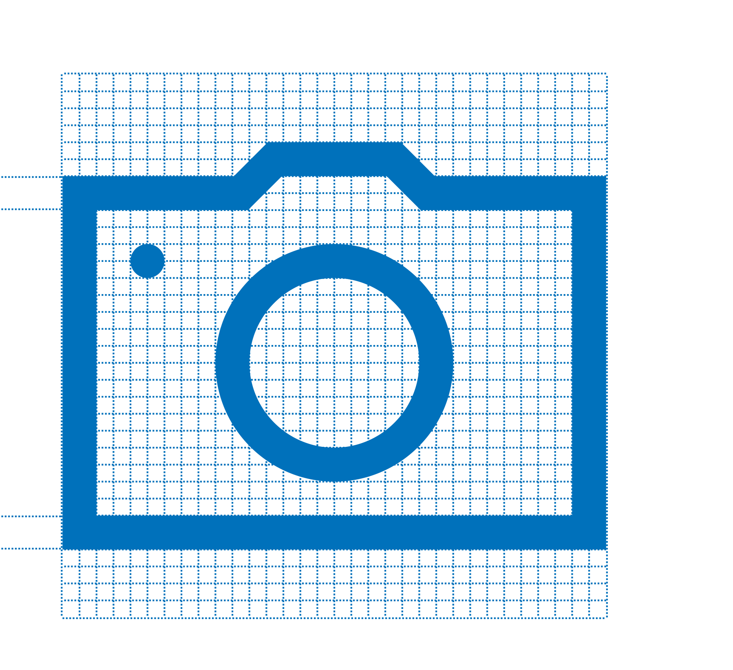
Iconography
2px

Slide 7
For most text, use 15 epx Segoe UI Regular

Slide 8
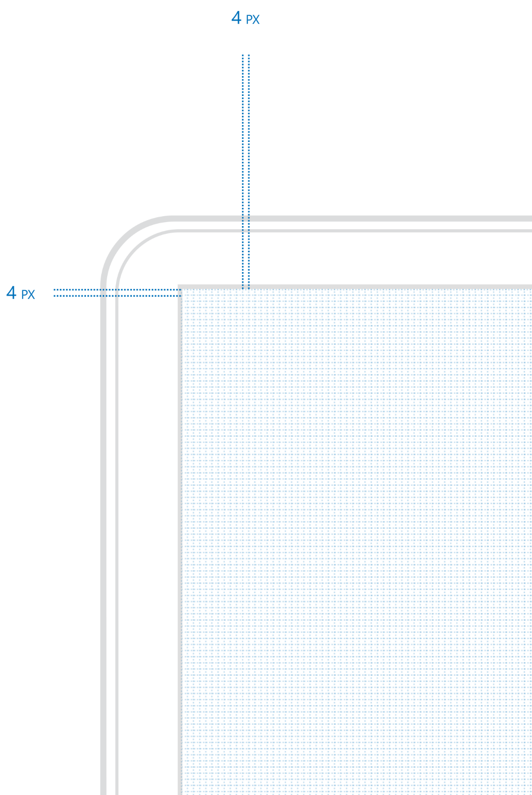
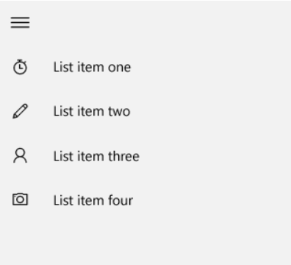
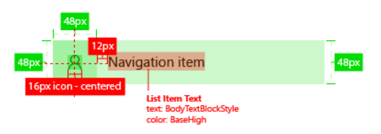
Four is the magic number

Slide 9
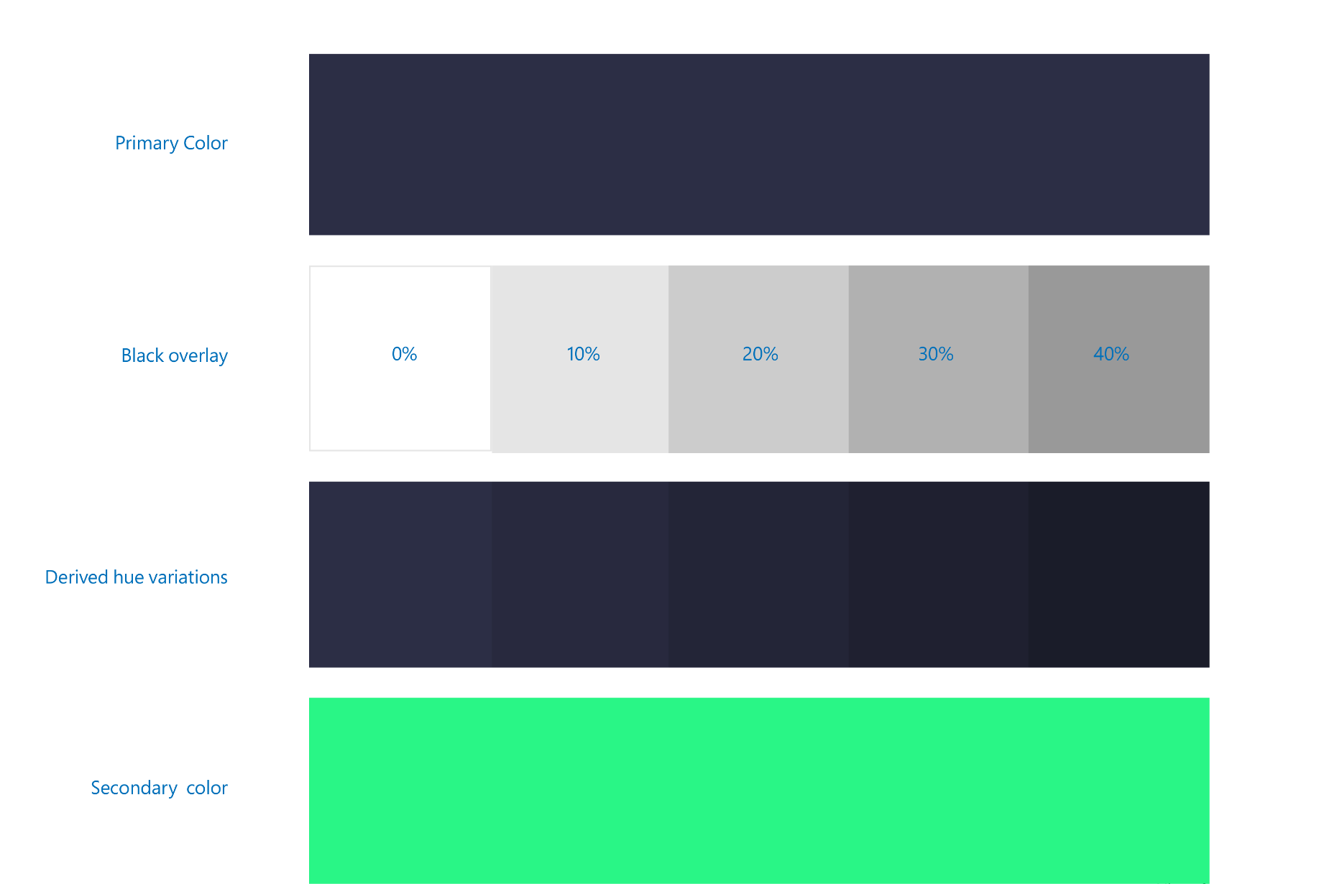
Color ramps

Slide 10
How Windows makes design easier

Slide 11


Adaptive controls

Slide 12


Input intelligence

Slide 13
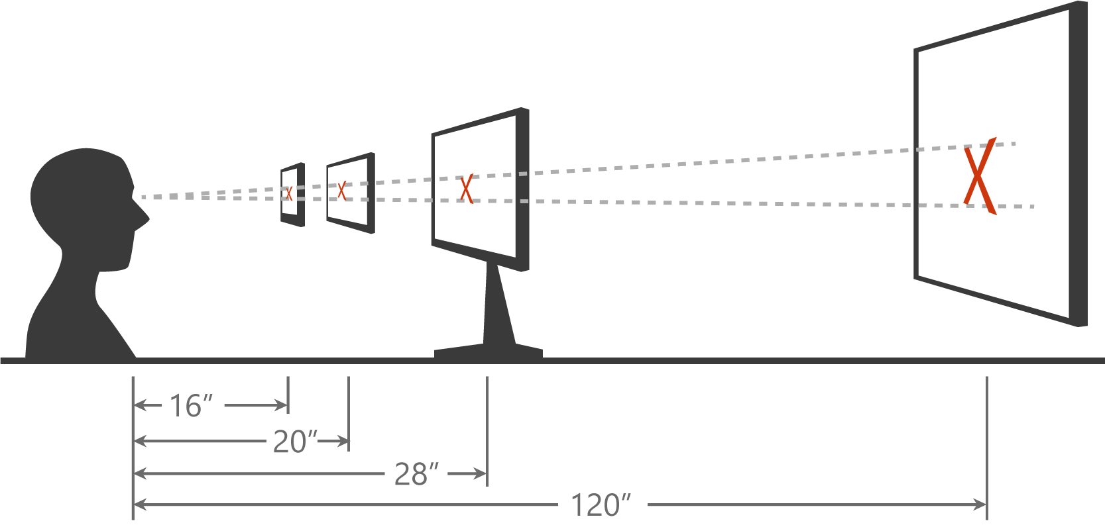
Scaling algorithm

Slide 14
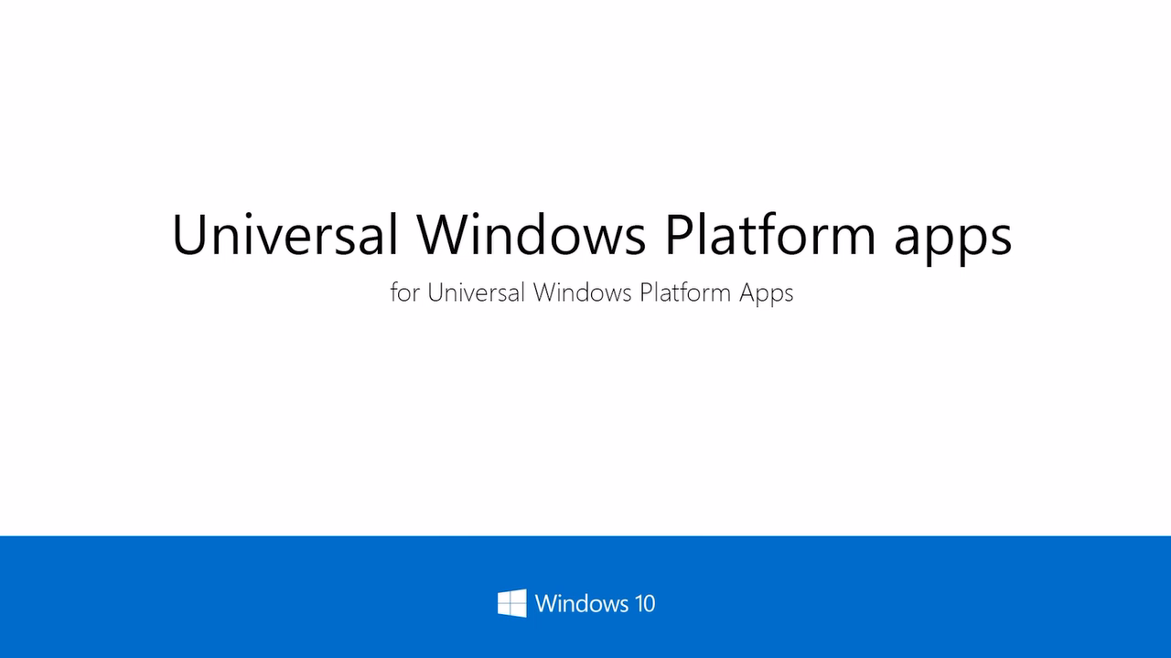

Slide 15
Physical versus effective pixel
4” Phone
480x854
4” Phone
480x854
5” Phone
720x1280
5” Phone
720x1280
6” Phone
1080x1920
6” Phone
1080x1920

Slide 16
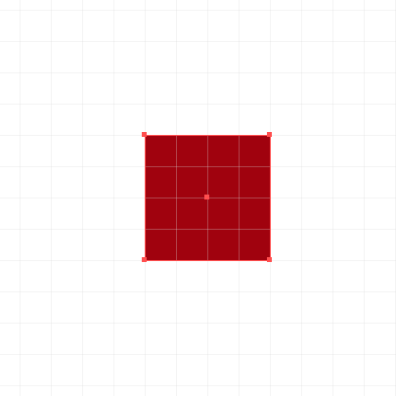
Effective pixel
Physical Pixel
Effective Pixel

Slide 17
Ignore scale, resolution, & dpi. Design in Effective Pixels

Slide 18
What am I designing?

Slide 19
Planning your design
5”
8”
13”
Phone
Viewing Distance: 16.3”
Tablets and 2 in 1
Viewing Distance:
20”
Small and Large Laptops
Viewing Distance:
24.5”
Small and Large Desktop Monitors
Viewing Distance:
28”
TV
Viewing Distance:
84”

Slide 20
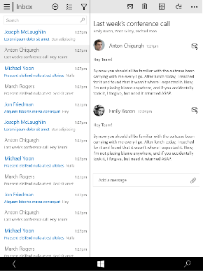
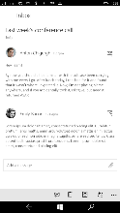
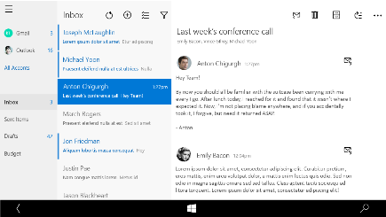
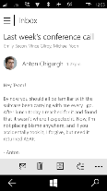
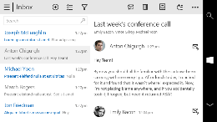
Snap points
epx
320
548
720
1024
phone
phablet & tablet
desktop
limited landscape support
one frame at a time
sys tray on the left
steering wheel on the right
4+ actions on the bottom
tabs are centered
limited landscape support
one frame at a time
sys tray on the left
steering wheel on the right
4+ actions on the bottom
single column stops scaling
tabs are centered
full landscape support
two frames
actions at the top
one “…” visible - TBD
tabs are left aligned
Show search field if search was represented as an icon on smaller devices
full landscape support
three frames
compact nav pane
actions at the top
one “…” visible
tabs left aligned

Slide 21
The weather app

Slide 22
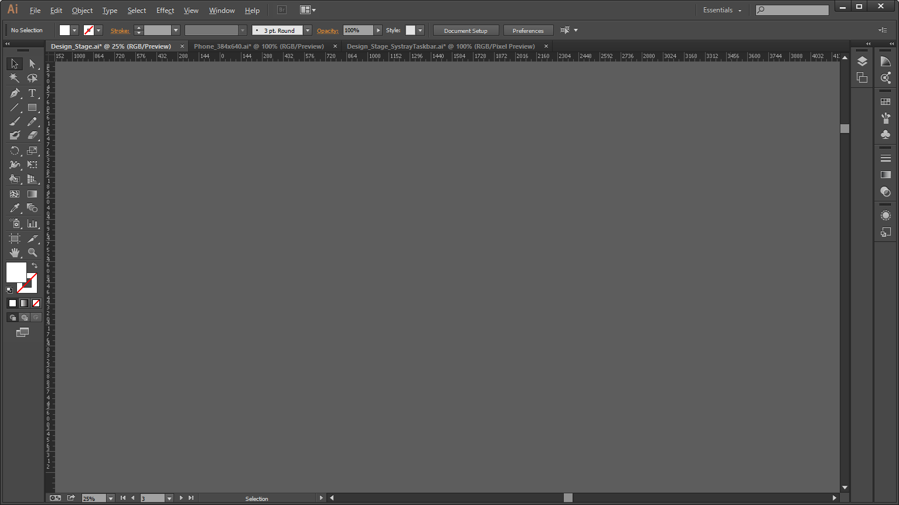
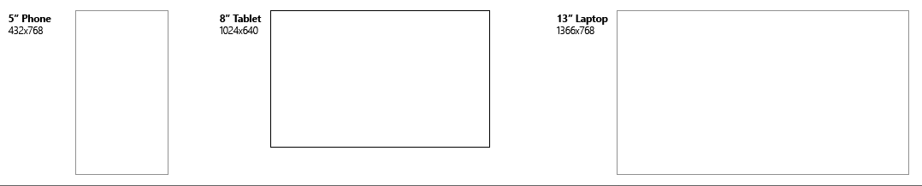
Flow, not size
My UI
My UI
My UI

Slide 23
Flow, not size
My UI
My UI
My UI
My UI
My UI
My UI

Slide 24
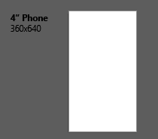
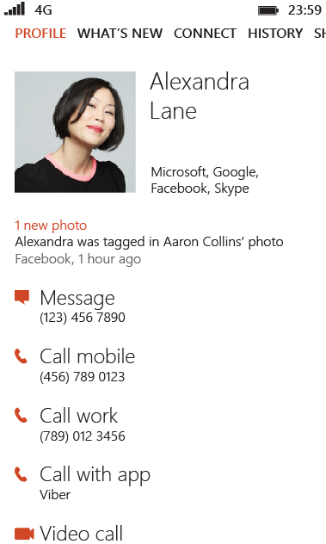
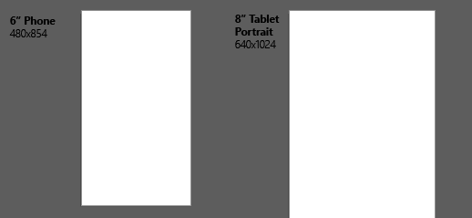
Check variants

Slide 25
As you design
Adapt to size change
Adapt to input change
Build with effective pixels
Count on the scaling algorithm

Slide 26
Where to start
Effective pixels
Iconography
Design templates

Slide 27
Techniques to adapt

Slide 28
Three core adaptive approaches
Responsive design
Resize your content
Reflow your content
Adaptive design
Reposition your content
Redesign your content
Tailored design

Slide 29
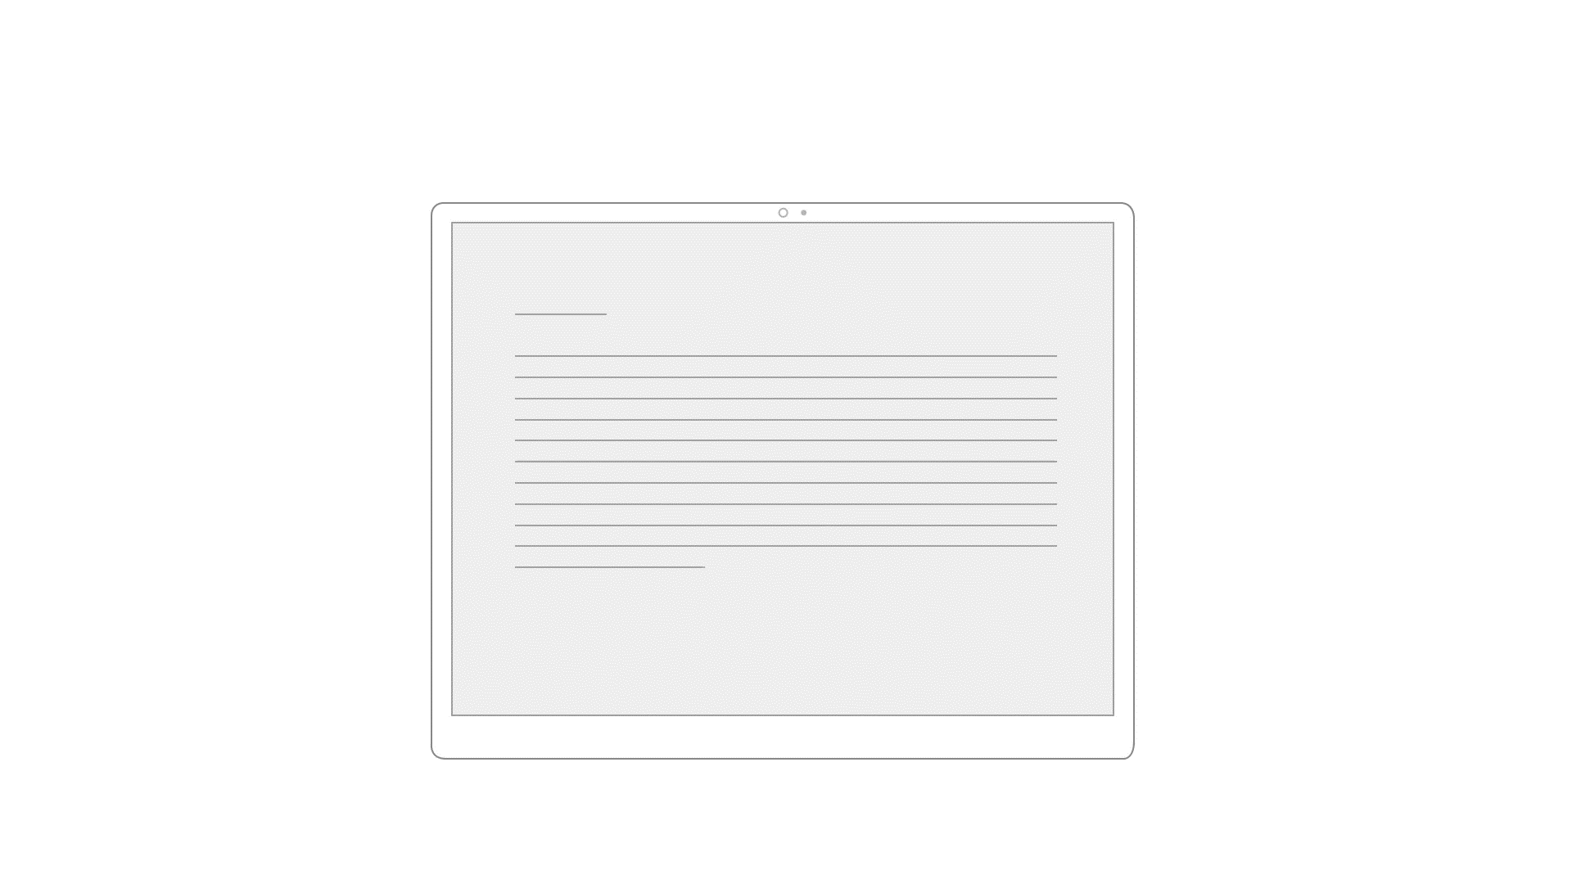
Resize

Slide 30
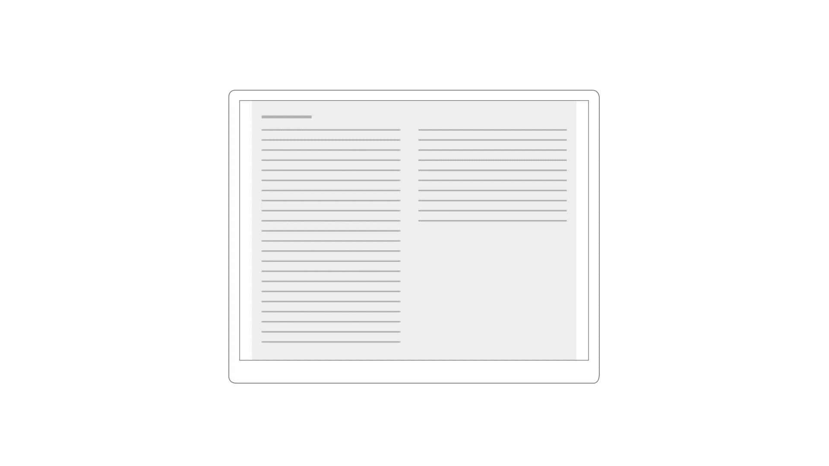
Reflow

Slide 31
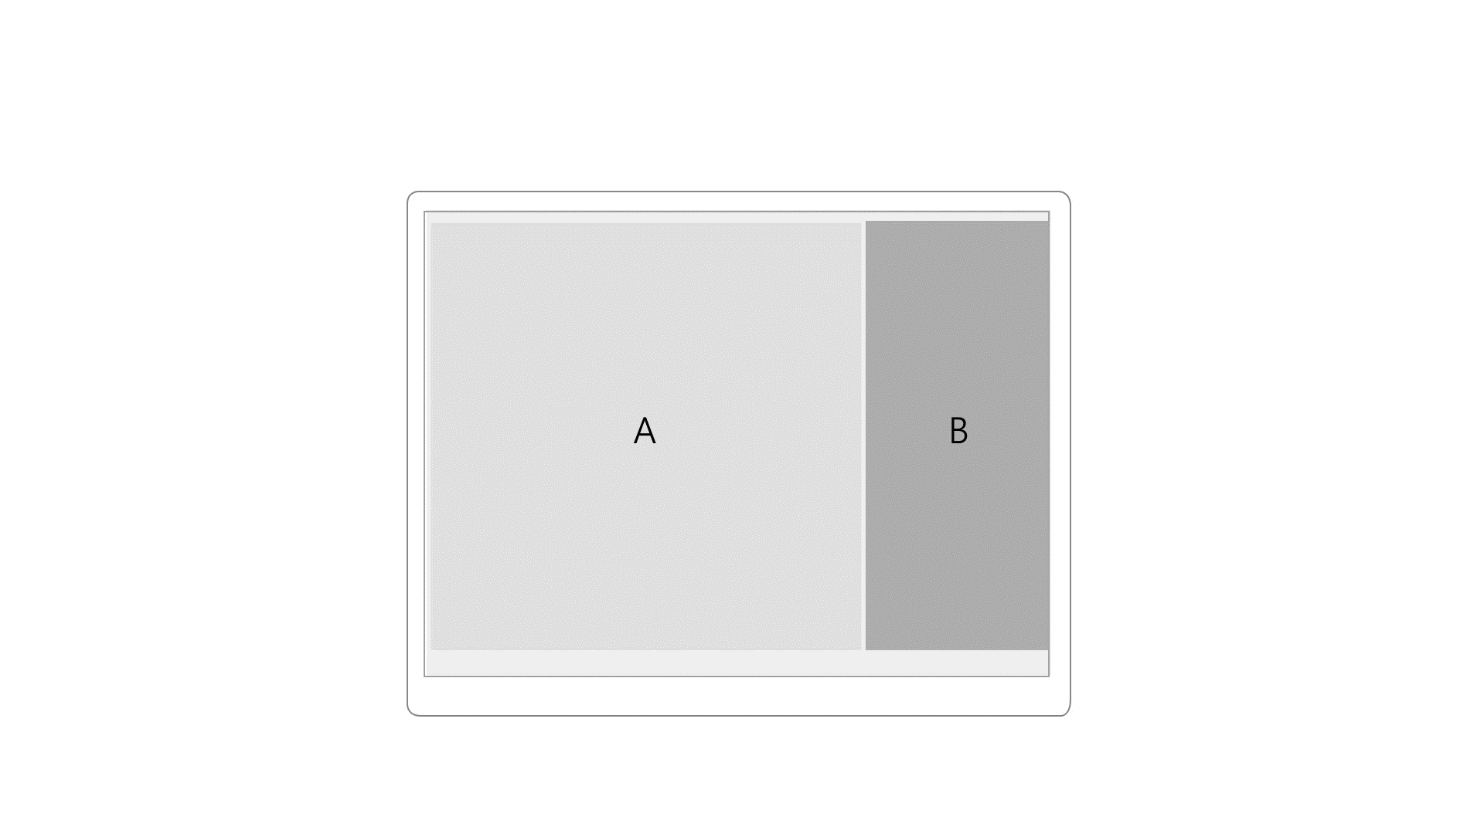
Reposition

Slide 32
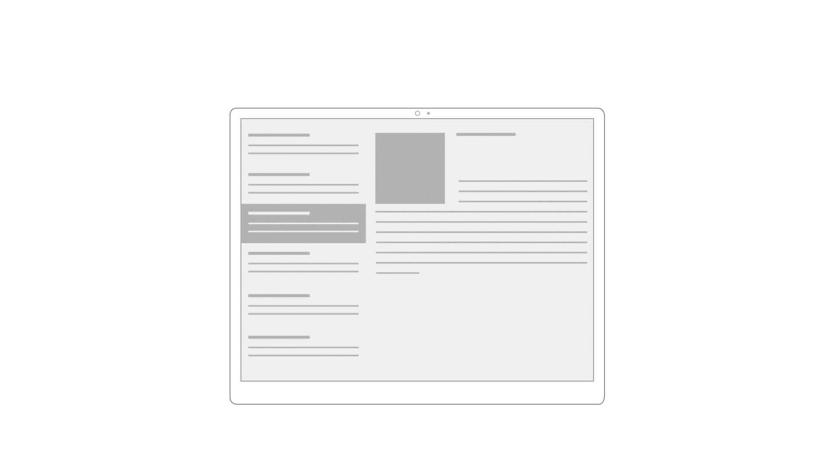
Redesign

Slide 33
Don't assume you will use only one technique.

Slide 34
The Microsoft design language
How Windows makes design easier
What am I designing?
Techniques to adapt

